Slide 1

Implementation Models
(Deployment Model)

Slide 2
Deployment Diagram
Software components developed as part of the development process would need to be deployed on some set of hardware or software to be executed
Deployment diagram maps the software architecture created in design to the physical system architecture that executes it. In distributed systems, it models the distribution of the software across the physical nodes.
Deployment diagrams shows how the components described in component diagrams are deployed in hardware.
Deployment diagrams are used to visualize
The topology of the physical components of a system, where the software components are deployed.
Describe the hardware components used to deploy software components.
Describe the runtime processing nodes (physical hardware) .

Slide 3
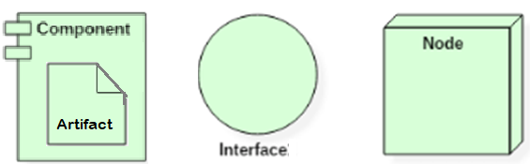
Deployment Diagram
Deployment diagrams are useful for system engineers. An efficient deployment diagram is very important as it controls the following parameters −
Performance
Scalability
Maintainability
Portability
Understandability
The software systems are manifested using various artifacts, and then they are mapped to the execution environment like servers called nodes that is going to be execute the software. Since there can be many nodes, the relation between then is represented as communication links
Some of the deployment diagram symbols and notations
Notes:
. Many nodes or physical devices can be involved in the deployment diagram; hence, the relation between them is represented using communication paths.
Typically developing the deployment diagram involves identifying the Nodes and Relationships among Nodes
Some of the deployment diagram symbols and notations

Slide 4
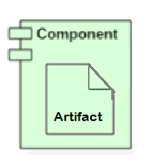

Deployment Diagram
Component with Artifacts : represents the concrete real-world entity related to software development.
Things that participate in the execution of a system or executable entities that reside in nodes
Represent the physical packaging of the logical elements
Artifacts are deployed on the nodes.
The most common artifacts are as follows,
Source files
Executable files
libraries
Scripts
Configuration files
User manuals or documentation
Output files
Each artifact has a filename in its specification that indicates the physical location of the artifact.

Slide 5
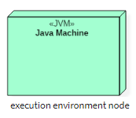
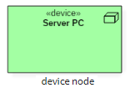
Deployment Diagram
Node : Node is a computational resource upon which component artifacts are deployed for execution.
Executes components or Artifacts that are deployed on nodes
Physical element in the run-time environment that represents a computational resource
Can be organized by grouping them in packages
Set of artifacts or components allocated to a node is a distribution unit
Device is a node that is used to represent a physical computational resource in a system. An example of the devices is like an application Server
Connection represents an association among nodes eg. Ethernet

Slide 6
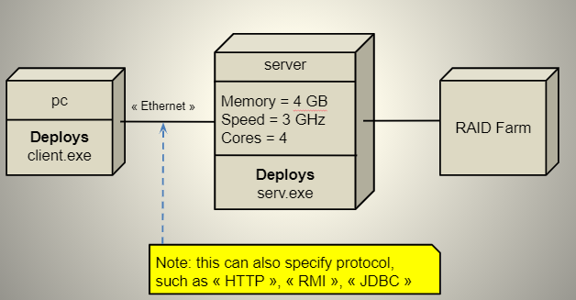
Illustration of a Deployment Diagram
Client Server

Slide 7
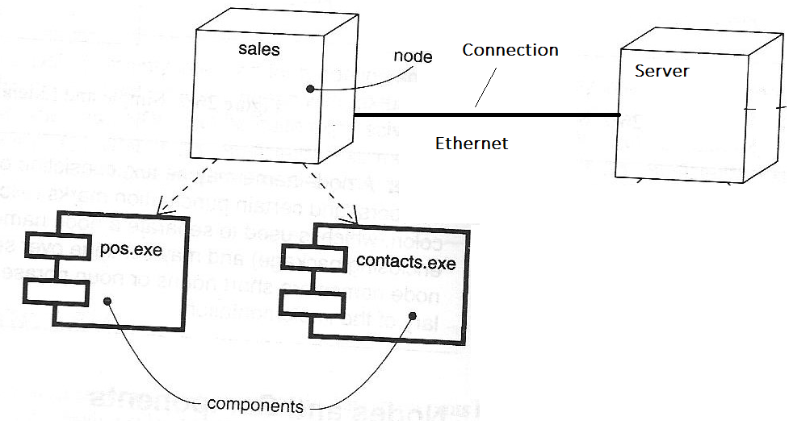
Illustration of a Deployment Diagram

Slide 8
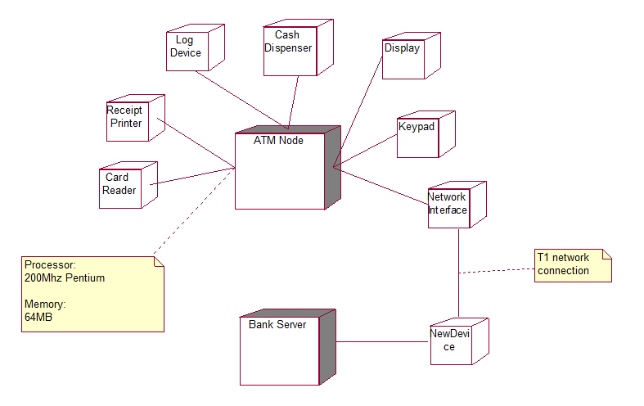
Illustration of a Deployment Diagram

Slide 9
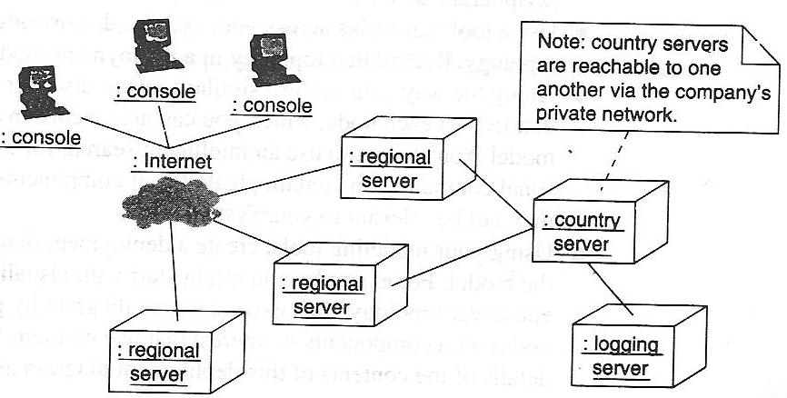
Illustration of a Deployment Diagram

Slide 10
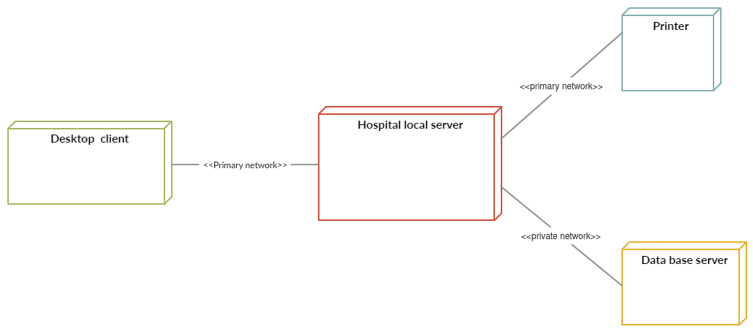
Illustration of a Deployment Diagram
Deployment Diagram for Hospital Management System Template

Slide 11
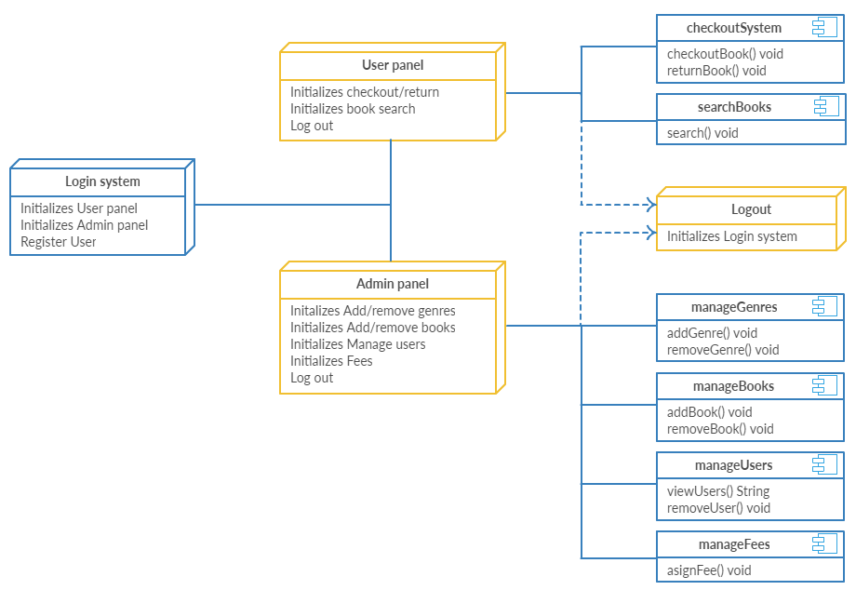
Illustration of a Deployment Diagram
Deployment Diagram for Library Management System Template

Slide 12
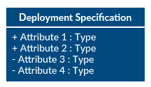
Deployment Diagram :
Deployment Specification
Deployment specifications is a configuration file, such as a text file or an XML document. It describes how an artifact is deployed on a node.
How to Draw deployment Diagram
Step 1: Identify the purpose of your deployment diagram. And to do so, you need to identify the nodes and devices within the system you’ll be visualizing with the diagram.
Step 2: Figure out the relationships between the nodes and devices. Once you know how they are connected, proceed to add the communication associations to the diagram.
Step 3 : Identify what other elements like components, active objects you need to add to complete the diagram.
Step 4: Add dependencies between components and objects as required.

